Slide 1

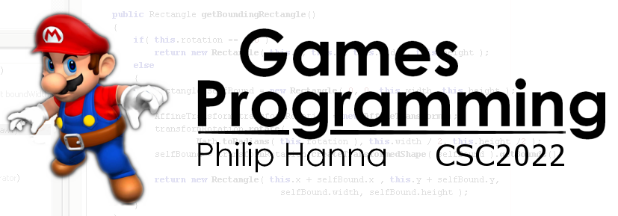
Path finding
Deciding how best to get from point A to point B.

Slide 2

Path finding

Slide 3
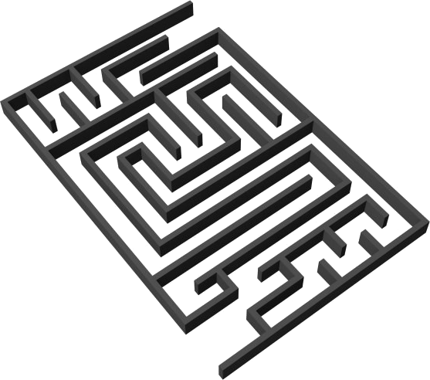
Path finding is the process of finding a path from a specified source position to a specified target position.
To do this some means of defining the search space is needed alongside an algorithm which will plan a walk from source to target.
The most common representations are:
Grids
Waypoint graphs
Navigation meshes
Aside: The returned path usually ignores small and/or moving objects – which can be handled by steering behaviours.

Slide 4
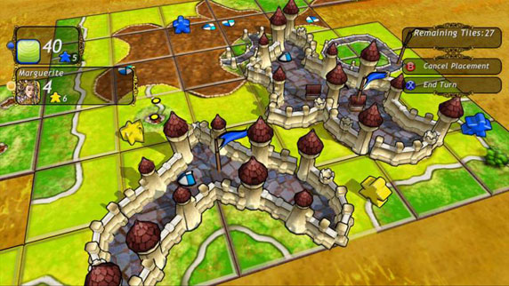
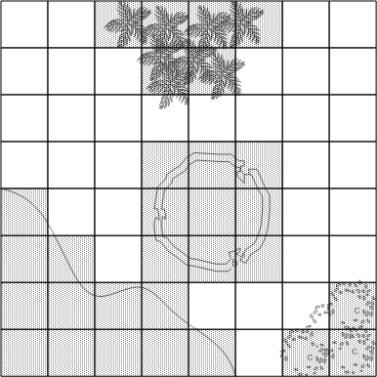
: Tile Based
Intuitive representation - works well with tile-based games.
Each node represents the centre of a cell, with the edges denoting connections between cells.
Each cell can be flagged as passable/impassable and/or given a terrain movement cost (e.g. forest, swamp, etc.). Large objects may occupy one or more cells.
Advantages:
Fast look-up
Easy access to neighbouring cells
Complete representation of the level

Slide 5
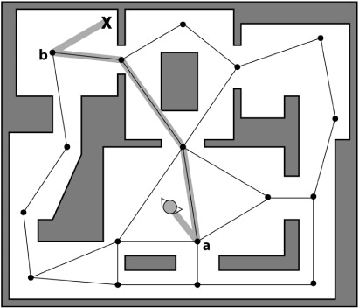
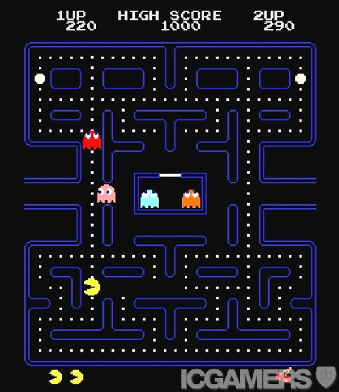
: Waypoint Graph
A waypoint graph defines straight routes between waypoints.
Advantages:
Nodes can be connected to any number of other waypoint nodes
Waypoint graphs can represent arbitrary level topologies and are ideal for games with restricted movement.
Can incorporate auxiliary information, e.g. ladders
Aside: Typically provides an incomplete representation of the level.

Slide 6
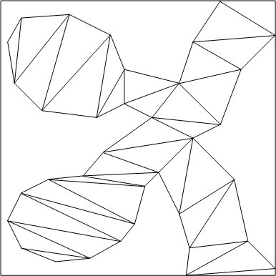
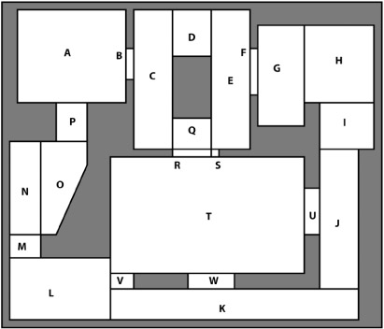
: Navigation Mesh
Combination of grids and waypoint graphs. Every node of a navigation mesh represents a convex polygon (as opposed to a single position).
Advantages:
Convex as any two points inside can be connected without crossing an edge of the polygon
Navigation mesh can be thought of as a walkable surface
Complete representation of the level

Slide 7
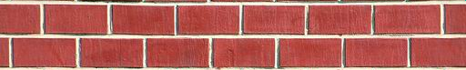
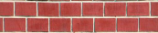
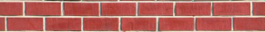

: Navigation Mesh
Advantages (continued):
Can be used to tie path finding and collision detection together
Can be used for 2D and 3D games

Slide 8

Path finding Algorithms

Slide 9
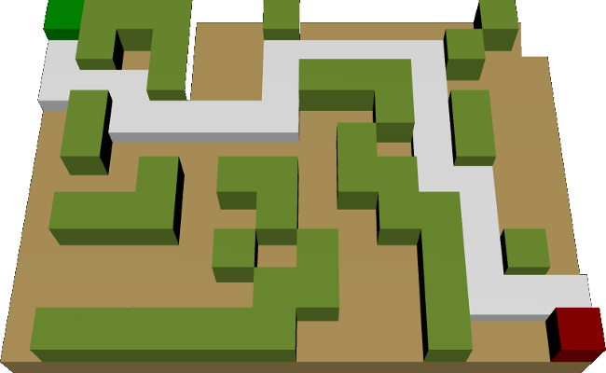
A path is a list of cells, points, or nodes that an agent must traverse. A path finding algorithm finds a path from a start position to a goal position. An algorithm that guarantees to find a path if one exists is a complete algorithm.
The path finding algorithm can be assessed in terms of:
Quality of final path
Resource consumption during search (i.e. CPU and memory)

Slide 10
: Basic - Seek + Random Avoidance
Seek combined with random movement when a direct seek cannot be executed is a simple and sometimes workable method of obstacle avoidance (particularly within environments with relatively small and sparse obstacles)
while( Goal not reached )
{
Move straight towards goal
if( blocked ) {
Move (sidestep) in random direction
}
}

Slide 11
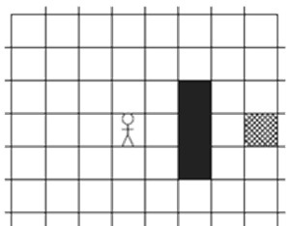
: Basic - Seek + Obstacle Tracing
Another simple approach of obstacle avoidance is to trace around the obstacle (useful for large objects that can be circumnavigated).
Tracing continues until a path straight towards the target can be obtained.
while( Goal not reached )
{
Move directly towards goal
if( Obstacle in way ) {
Trace around in (counter) clockwise
direction until path towards goal.
}
}

Slide 12
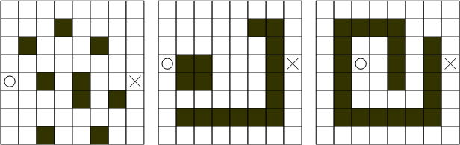

How will the previous algorithms handle the following environments:

Slide 13
: Basic – Breadcrumb Trace
Each time some target objects moves it leaves behind a ‘breadcrumb’ marker (an invisible marker recording the location of the object).
The source object can follow the breadcrumbs to the target.

Slide 14

More Complex Path finding

Slide 15
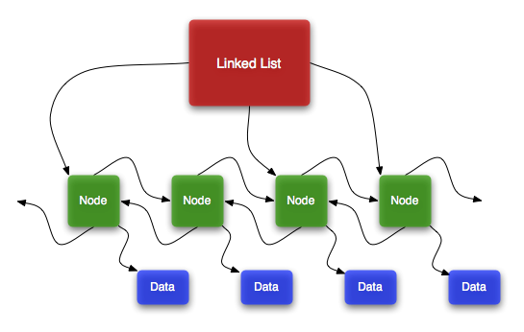
In order to provide a better algorithm (and one that actually produces a movement plan) we will consider the following types of algorithm: Breadth-First, Best-First, Dijkstra and A*
These algorithms use linked lists of nodes to represent candidate paths. They all use:
An open list
A closed list
The open list tracks promising nodes. A node is taken from the open list and used to create additional open nodes (which are added to the open list). The initial node taken from the open list is then added to the closed list. This is repeated until one of the open nodes reaches the goal.

Slide 16
: Common Structure
Create start point node and push onto open list
while( open list is not empty )
{
Pop node from open list call this currentNode
if( currentNode == goalNode ) {
Goal found
} else {
Create successor nodes for cells around
currentNode and push them onto open list
Put currentNode onto closed list
}
}
1 2 3 4 5 6 7
End
Start
Open list: { }
Closed list: { )
Open list: { (2,4) }
Closed list: { )
Open list: { (1,3), (2,3), (3,3), (1,4),
(3,4), (1,5), (2,5), (3,5) }
Closed list: { (2,4) )
Questions:
● What node should be popped from open list?
● Which successor nodes should be created?

Slide 17
: Breath First Search
Finds a path from the start to the goal by examining the search space ply-by-ply
Which node is popped?
● Node that been waiting the longest
Which successor nodes are added?
● Every point around the currentNode that is not impassable or already created
End
End
End
End
End
End
End
End
Start
Start
Start
Start
Start
Start
Start
Start

Slide 18
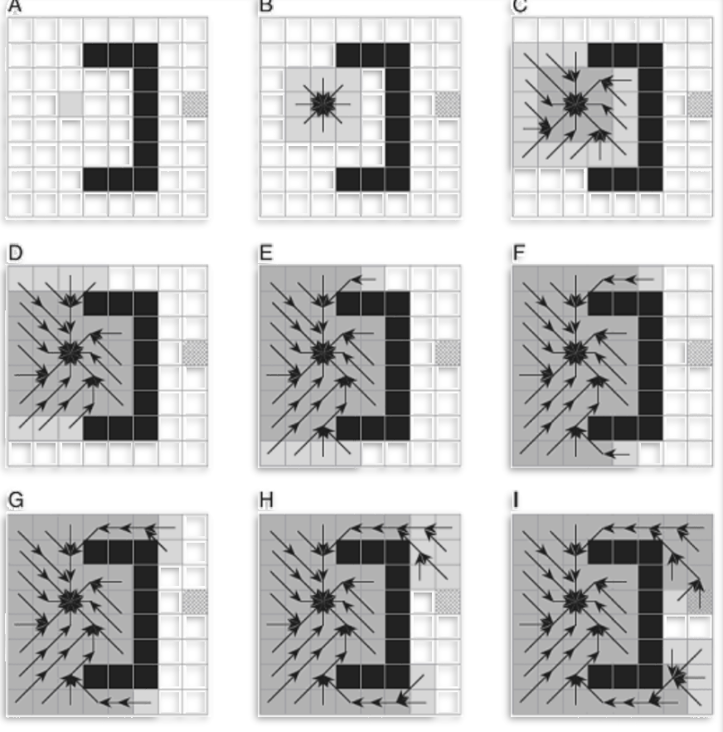
: Breath First Search
Exhaustive search (systematic, but not clever)
Consumes substantial amount of CPU and memory
Guarantees to find paths that have fewest number of nodes in them (not necessarily the shortest distance!)
Complete algorithm

Slide 19

: Best First Search
Uses problem specific knowledge to speed up the search process, i.e. is a heuristic search
Computes the distance of every node to the goal
Uses the distance (or heuristic cost) as a priority value to determine the next node that should be brought out of the open list
Which node is popped?
● Open node that is closest to the goal
Which successor nodes are added?
● Every point around the current node that is not impassable or already created

Slide 20
: Best First Search
Which node is popped?
● Open node that is closest to the goal – using Euclidean distance
Which successor nodes are added?
● Every point around the currentNode that is not impassable or already created
End
End
End
End
End
End
End
End
Start
Start
Start
Start
Start
Start
Start
Start
Uses fewer resources than Breadth-First
Tends to find good paths
Complete algorithm

Slide 21
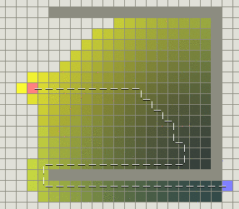
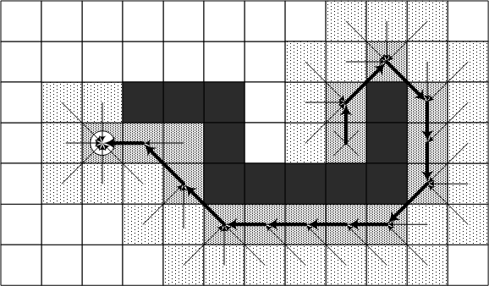
: Best First Search
Not guaranteed to find most optimal path

Slide 22
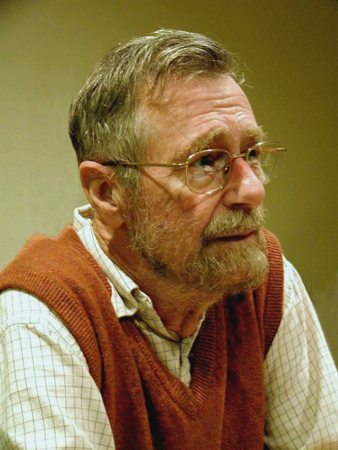
: Dijkstra Search
different
Disregards distance to goal
Keeps track of the cost of every path – i.e. computes accumulated cost paid to reach a node from the start
Uses the cost (called the given cost) as a priority value to select the next node from the open list
Which node is popped?
● Open node that is attached to path with lowest cost
Which successor nodes are added?
● Every point around the currentNode that is not impassable or already created.

Slide 23
different
: Dijkstra Search
3
3
3
3
3
3
3
3
3
3
3
3
3
3
3
3
3
3
3
3
4
4
4
4
4
3
4
3
3
3
3
3
3
3
3
3
3
3
3
3
3
3
3
5
5
5
5
Which node is popped?
● Open node that is attached to path with lowest cost
Which successor nodes are added?
● Every point around the currentNode that is not impassable or already created.
2
2
2
2
2
2
2
2
2
2
2
2
2
2
2
2
2
2
2
2
2
2
2
2
2
2
2
2
3
3
3
3
3
3
3
3
4
4
4
4
4
4
5
5
5
2
5
2
2
2
2
2
2
2
2
2
2
2
2
6
1
1
1
1
1
1
1
1
1
1
1
1
1
1
1
1
1
1
1
1
1
1
1
1
1
1
1
1
1
1
4
4
4
4
4
4
5
5
5
5
6
End
End
End
End
End
End
End
End
End
End
End
End
End
End
End
End
1
1
1
1
1
1
1
1
1
1
1
1
1
1
1
5
5
1
5
1
1
1
1
1
1
1
1
1
1
1
1
1
1
Start
6
Start
Start
Start
Start
Start
Start
Start
Start
Start
Start
Start
Start
Start
Start
Start
Exhaustive search
At least as resource intensive as Breadth-First
Always finds the most optimal path
Complete algorithm
1
1
1
1
1
1
1
1
1
1
1
1
1
1
1
5
1
5
1
1
1
1
1
1
1
1
1
1
1
1
1
1
1
1
1
1
1
1
1
1
1
1
1
1
1
1
1
5
4
5
4
4
4
3
4
3
3
3
3
3
2
3
2
2
2
2
2
2
2
2
2
2
2
2
2
2
2
2
2
2
2
2
2
2
2
2
2
2
2
2
2
2
2
2
2
2
2
2
2
2
2
2
2
2
2
2
2

Slide 24
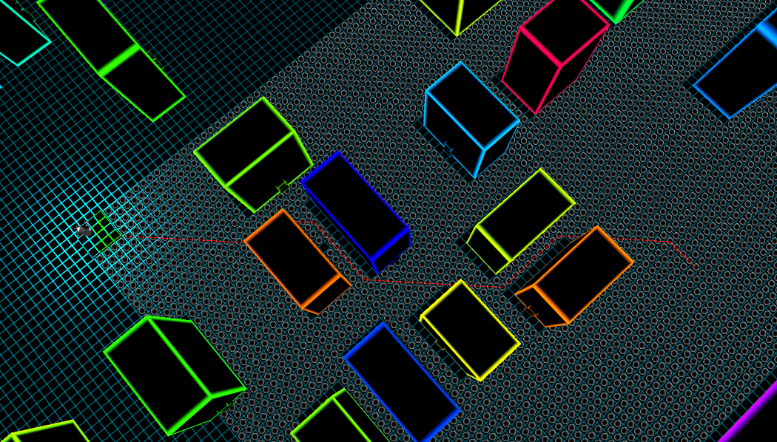
A* Path finding

Slide 25
: A* Algorithm
Which node is popped?
● Open node that is attached to path with lowest cost
Which successor nodes are added?
● Every point around the currentNode that is not impassable or already created.
● If needed, update path/cost to a node if lower cost path found
Combination of best-first and Dijkstra searches.
Uses both heuristic cost and given cost to order the open list
Start
Given cost = measured cost to reach node
End
Path Cost = Given Cost
+ (Heuristic Cost * Heuristic Weight)
Heuristic cost = estimate of cost to end node

Slide 26
: A* Algorithm
7
7
7
7
7
6
7
6
6
Which node is popped?
● Open node that is attached to path with lowest cost
Which successor nodes are added?
● Every point around the currentNode that is not impassable or already created.
● If needed, update path/cost to a node if lower cost path found
7
6
6
6
6
6
6
6
7
6
7
7
7
6
6
6
8
6
7
8
8
8
8
6
6
7
7
7
7
7
6
6
6
6
7
6
7
7
7
6
6
6
6
6
6
6
6
6
6
End
End
End
End
End
End
End
End
End
End
5
5
5
5
5
5
5
5
5
5
5
5
5
5
5
5
5
7
5
7
7
7
7
7
7
7
7
7
Start
Start
Start
Start
Start
Start
Start
Start
Start
Start
7
7
7
7
7
6
6
6
6
6
5
5
5
5
7
5
7
7
7
6
6
6
6
5
5
5
5
Path Cost = Given Cost
+ (Heuristic Cost * Heuristic Weight)
6
6
6
7
6
7
7
7
5
5
5
5
6
6
6
7
6
7
6
6
7
6
7
7
7
5
5
5
5
6
6
6
6
7
7
7
7
On average, uses fewer resources than Dijkstra and Breadth-First.
Admissible heuristic (i.e. never overestimated true cost) will find optimal path.
Complete algorithm.

Slide 27
Create startNode and push onto open list (cost = heuristicCost(startNode→endNode)
while( open list is not empty )
{
Pop node with lowest cost and assign to currentNode
if( currentNode == endNode )
{ Goal found; Break }
else {
for( every node connected to currentNode ) {
Create successorNode (cost = givenCost(startNode→successorNode)
+ heuristicCost (successorNode→endNode, parent = currentNode )
if( successorNode has been visited before )
if( successorNode has a lower cost than the current stored node)
{ Replace the ‘old’ node with successorNode (a better path was found) }
else { Ignore this successorNode ) }
else
Push the successorNode onto the open list
}
Push the currentNode onto the closed list
}
Backtrack from currentNode through parent nodes and invert to return path
Lowest cost based on known added with heuristic cost
The navigation graph will be queried to return possible linkage
The parent node is stored to permit backtracking
A* Algorithm
Both the open and closed lists will need to be searched to check for already visited nodes
Add the unvisited node to the open list

Slide 28
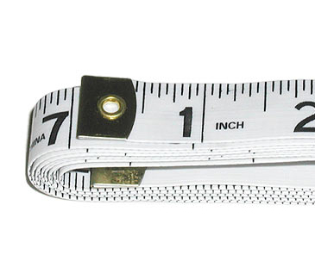
: Different Types of Heuristic
Underestimating Heuristics
A heuristic that underestimates the distance will result in a larger search space (i.e. longer execution time). A heuristic that always underestimates (or gets it right) is guaranteed to return the best possible path.
Overestimating Heuristics
A heuristic that overestimates the distance will tend to produce paths with fewer nodes (i.e. moving towards the goal faster, but potentially missing the best route, and lowering execution time).
Euclidean Distance (i.e. distance as the ‘crow flies’) is a common heuristic that is guaranteed to never overestimate. It is a good heuristic in open, outdoor settings, and not good within indoor settings (with lots of wall and doors).

Slide 29
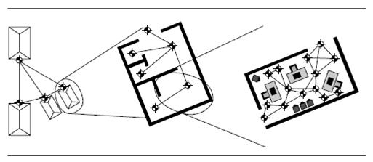
: Hierarchical Path finding
Hierarchical path finding plans a route in much the same way a person would, i.e. a high-level route is planned, and then refined.
Hierarchical path finding offers an effective means of path finding, i.e. a high-level route can be first planned with more detailed planning deferred until needed (i.e. improved computational loading, more easy to re-plan sections as needed).
It can be difficult to implement as the cost of each sub-journey must be, typically, heuristically estimated (i.e. issues of over- and underestimating arise).

Slide 30
: Adding Terrain Cost
The quickest path may not be the shortest path unless all terrain is equally ‘easy’ to traverse.
A game with different types of terrain might provide movement costs that depend on the type of terrain and capabilities of the moving object.
The extension to the basic A* algorithm is straightforward (although it can add some extra complexity into the heuristic cost prediction).

Slide 31

Key takeaways:
Path finding algorithms provide a means of planning the good routes through complex (but fixed) environments.
A* path finding offers a capable form of path finding that is reasonably efficient and highly flexible.

